Slide 1
TIME SERIES ANALYSIS
BY:
KAILASH S

Slide 2
CONTENTS
TOOLS USED
EXCEUTION OVERVIEW
ARCHITECTURE DIAGRAM
IMPLEMENTATION
TIME-SERIES ANALYSIS
PROJECT OVERVIEW
CONCLUSION

Slide 3
PROJECT OVERVIEW
Project Statement:
Implement time series analysis using Py Spark SQL on Azure Databricks. Process and analyze time-stamped data for trends, seasonality, and anomalies.
Project Overview:
This project aims to leverage PySparkSQL on Azure Databricks to conduct time series analysis on time-stamped data.
The objective is to identify trends, seasonality, and anomalies within the dataset.
By utilizing the power of Py Spark and the scalability of Azure Databricks, we can efficiently process large volumes of time series data for meaningful insights.
Project Requirements: ​
Azure Subscription
Data Sources
Azure Storage account
Azure Databricks
Familiarity with time series analysis concepts.
Visualization

Slide 4

PROJECT OVERVIEW
1.Azure Subscription:
A valid Azure subscription is required to access and utilize Azure services for hosting, managing, and analyzing data.
2.Data Sources:
I downloaded a sample time-stamped file from the website called Kaggle. From that I downloaded a file called “park-data.csv”. Click here
3.Azure Storage account:
Set up an Azure Storage account to store and manage the project's data efficiently, providing a scalable and secure solution for storing various types of data.
4.Azure Data Bricks:
● Utilize Azure Databricks, a cloud-based big data analytics platform, to perform advanced analytics and data processing tasks, leveraging its collaborative and scalable environment.
● Time series analysis and Visualization done in Databricks.

Slide 5
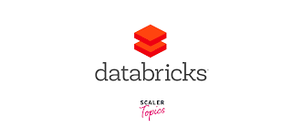


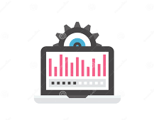
ARCHITECTURE DIAGRAM
Files
Azure Blob storage
Azure Data bricks
Data Processing and Visualization

Slide 6
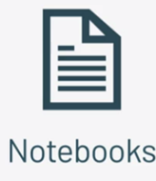
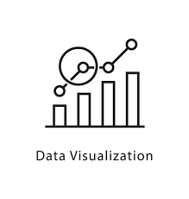
TOOLS USED
Azure Databricks
Azure Blob Storage
PySparkSQL
Notebooks for code execution and Visualization

Slide 7



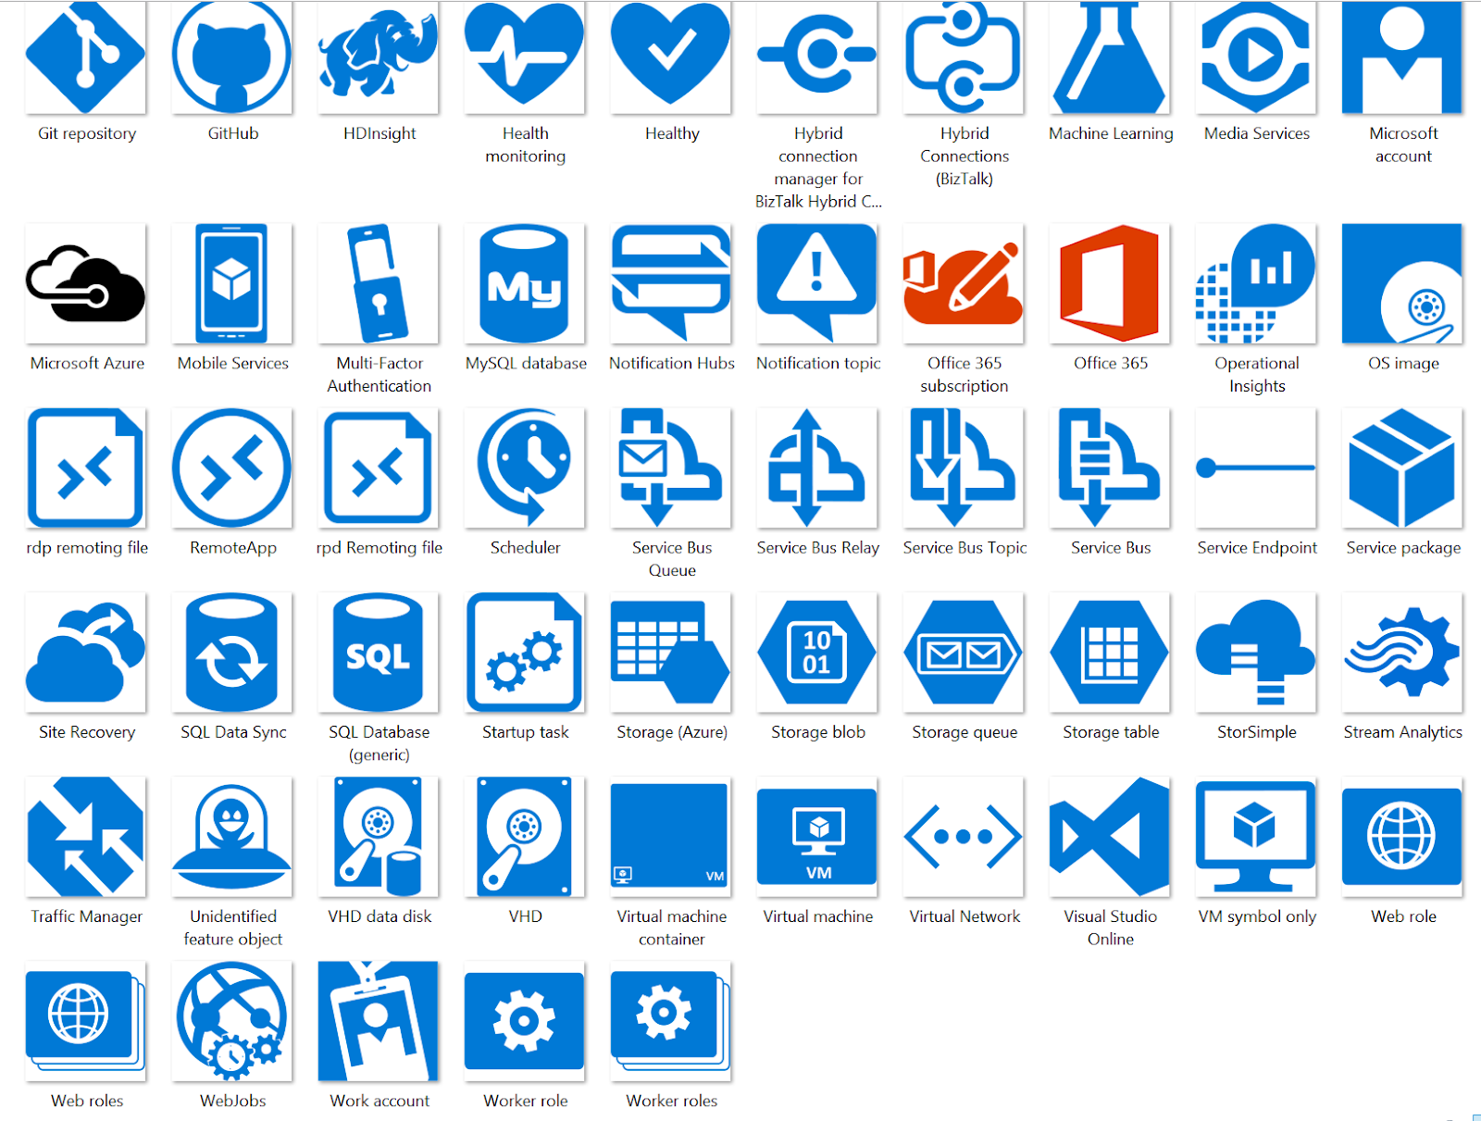




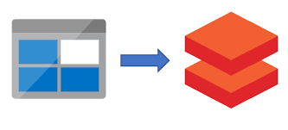
Execution Overview
Visualization
Time Stamped files
Utilize Databricks notebooks for interactive visualization
Plot trends, seasonality, and anomalies.
Download a sample time-stamped file
Time Stamped files.
Visualization
Azure blob storage
Time-Series Analysis
Azure blob Storage
Perform trend analysis, seasonality detection, and anomaly detection using appropriate queries.
Set up an Azure Storage account to store and manage the project's data efficiently, providing a scalable and secure solution for storing various types of data.
Time-Series Analysis
Azure data bricks
Load Data from Blob Storage
Easy to change colors.
Azure Databricks
Create an Azure Databricks workspace.
Configure necessary clusters and libraries.
Connect Azure Databricks to your Azure Storage Account.
Load time-stamped data into Spark Data Frame.

Slide 8
IMPLEMENTATION
Steps - How to Implement:
Set up an Azure Databricks environment.
Configure clusters and libraries.
Connect to Azure Blob Storage.
Load time-stamped data into Spark Data Frame.
Implement Py Spark SQL queries for trend analysis.
Implement Py Spark SQL queries for seasonality detection.
Implement Py Spark SQL queries for anomaly detection.
Visualize the results using Databricks notebooks.

Slide 9
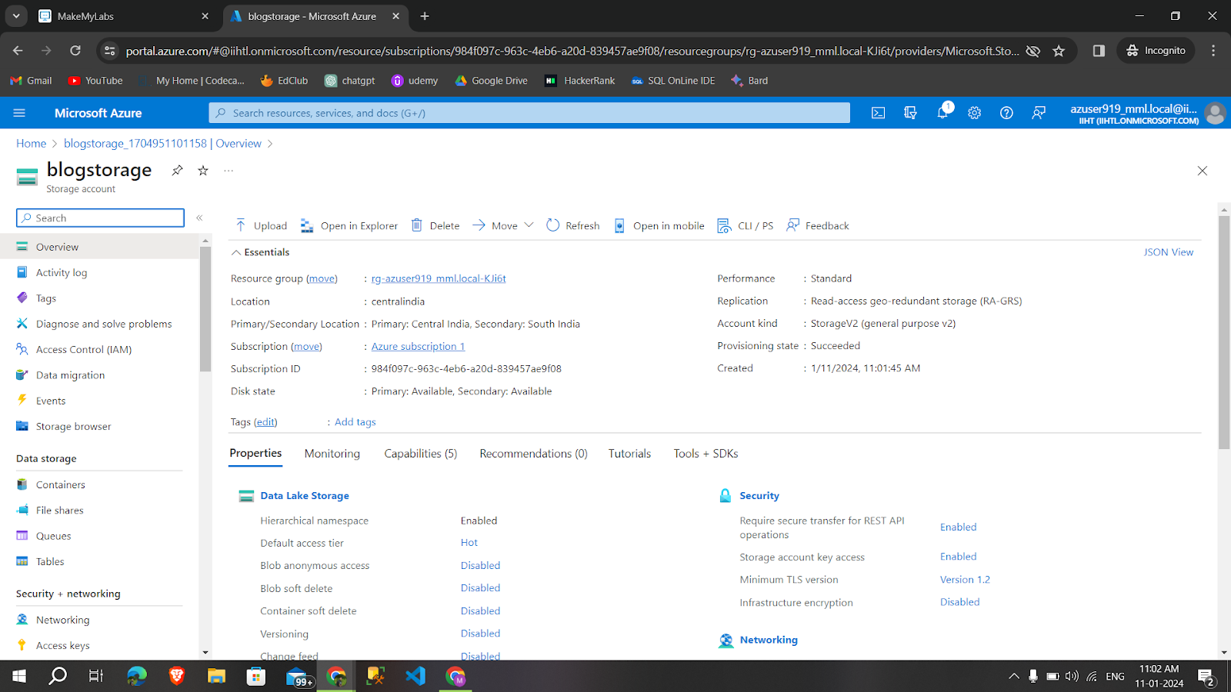
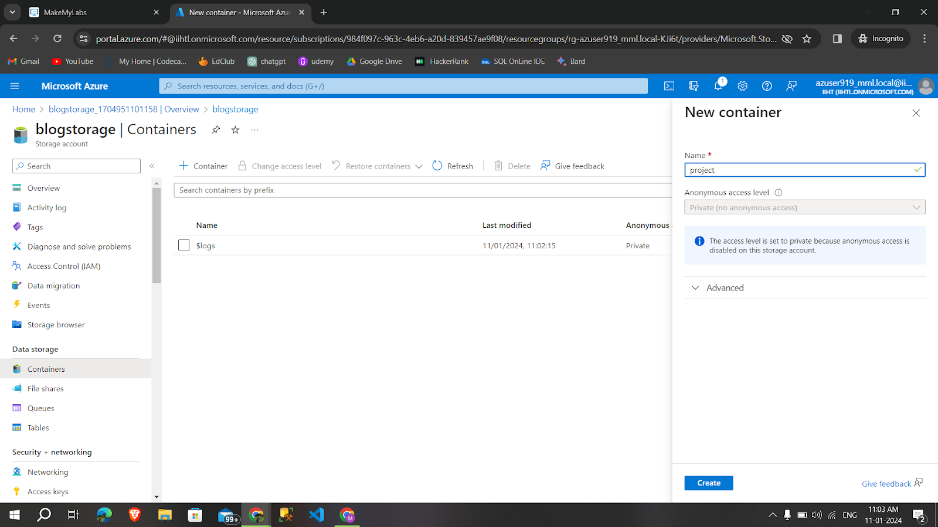
Create a Blob Storage and container

Slide 10
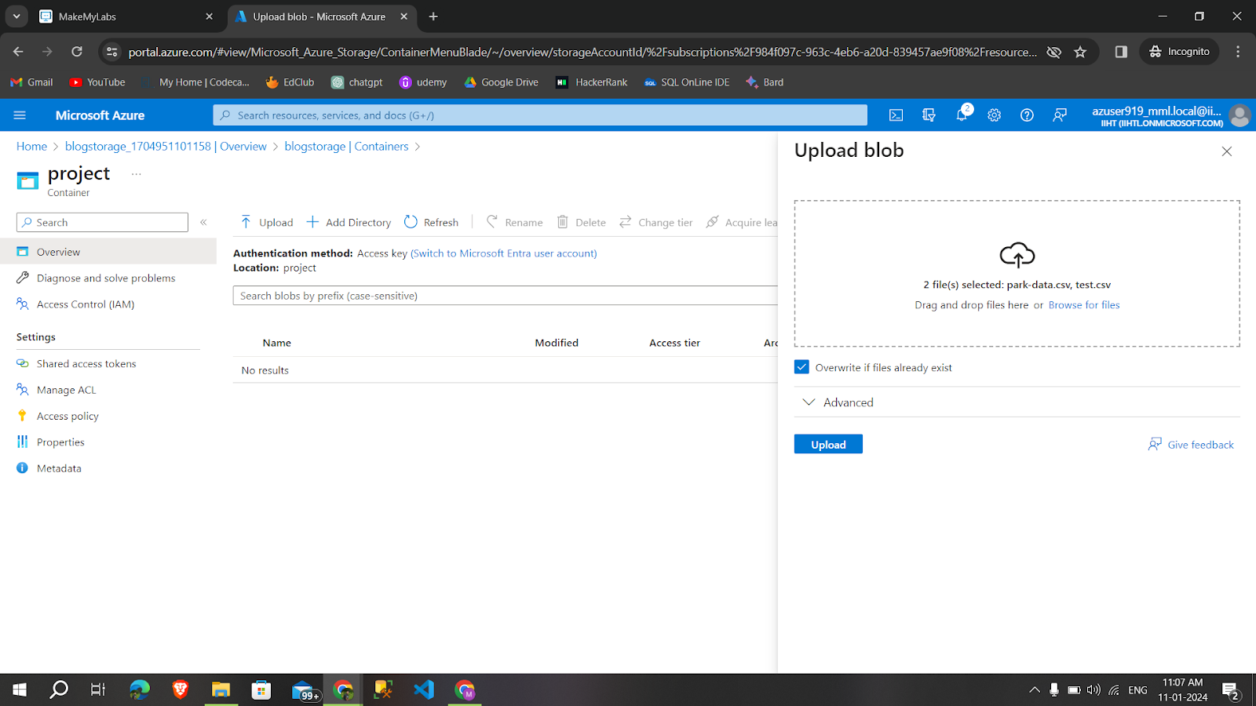
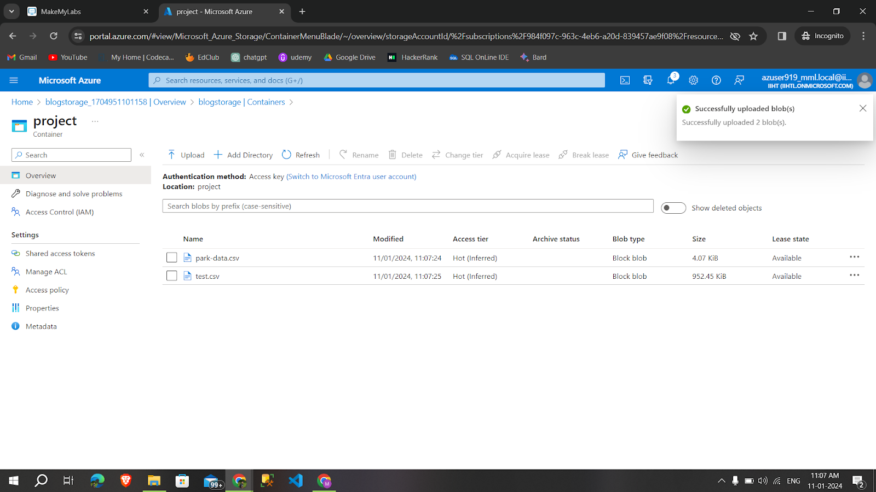
Upload a csv files in container

Slide 11
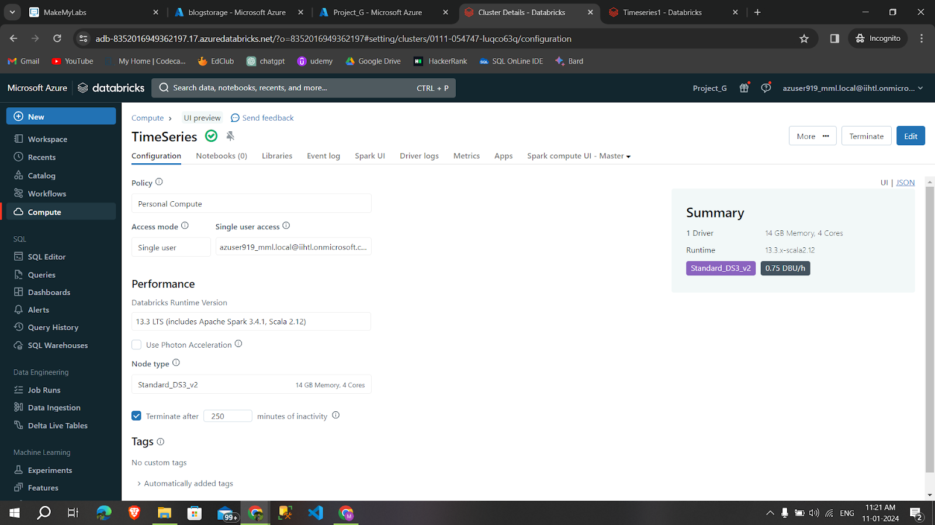
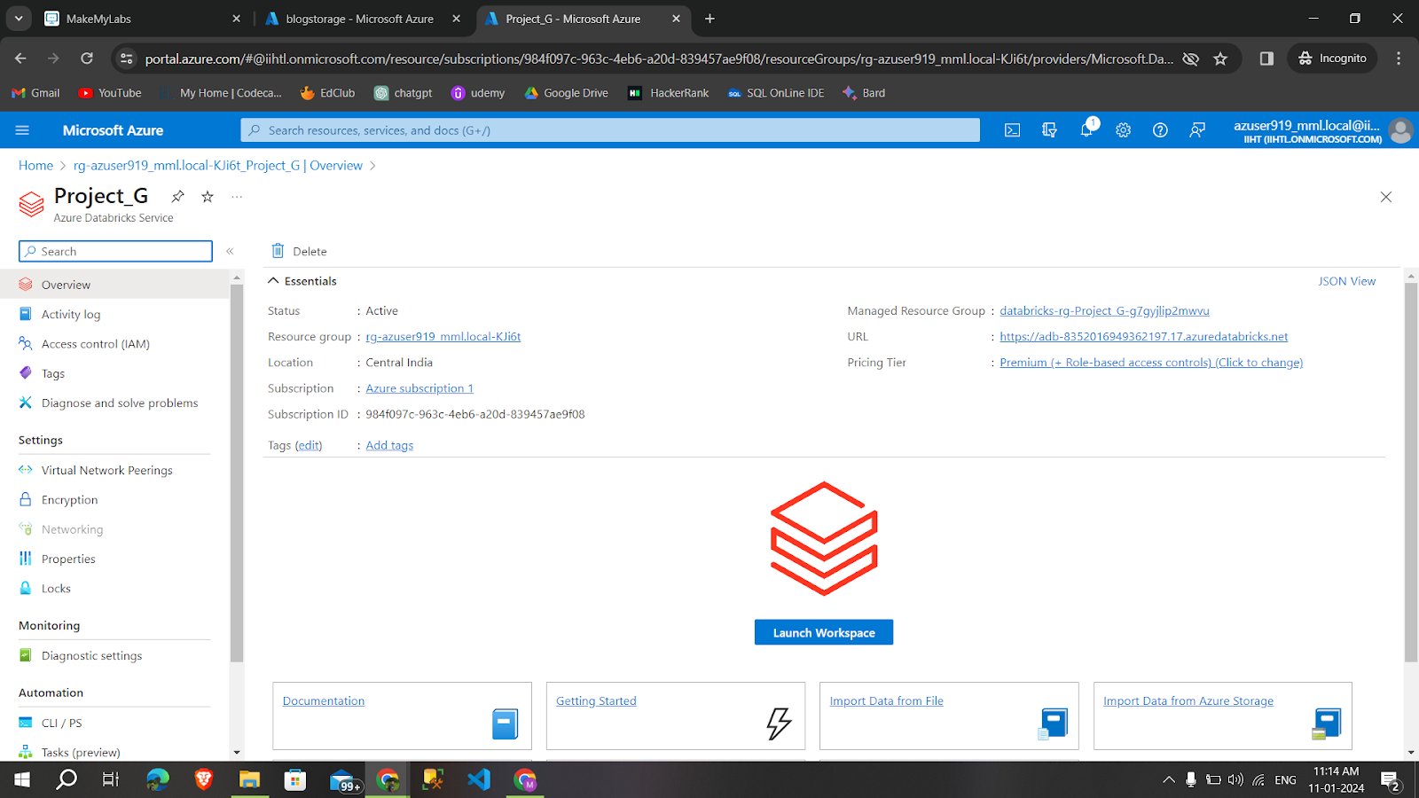
Create an azure data bricks workspace and cluster

Slide 12
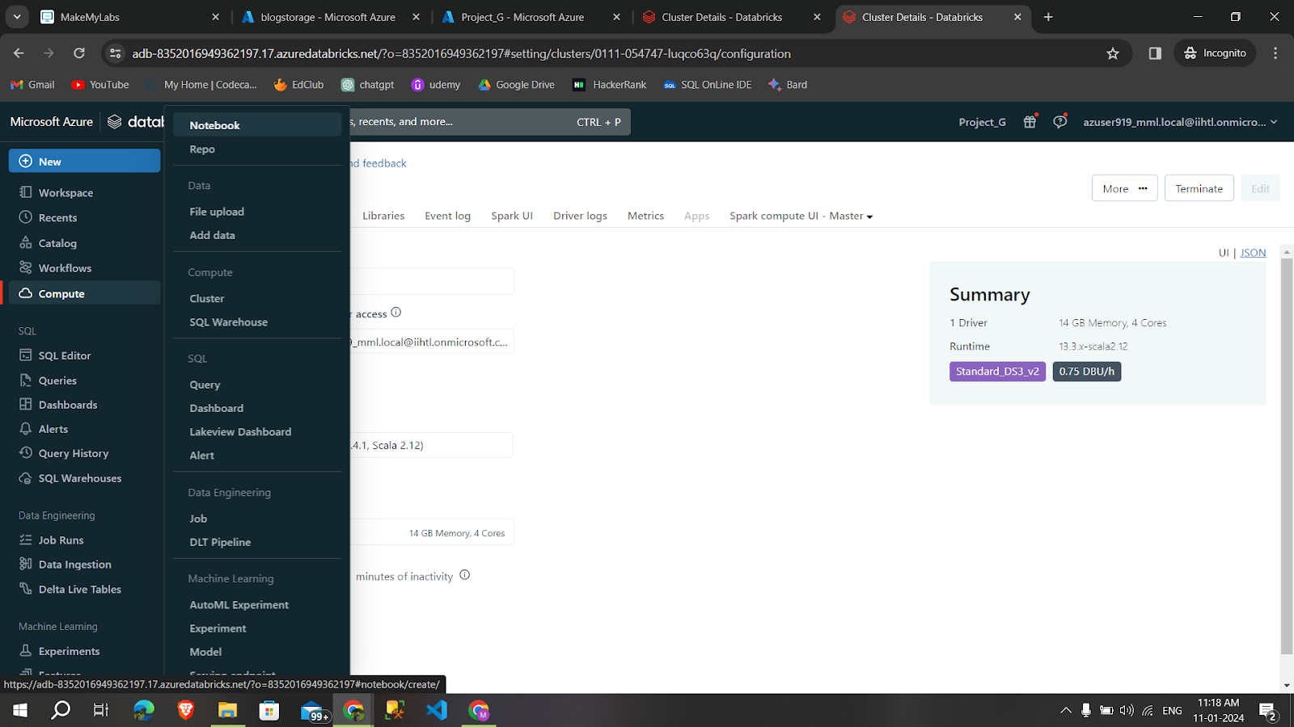
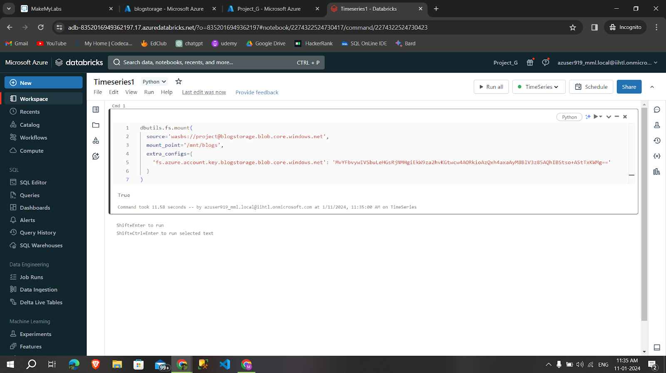

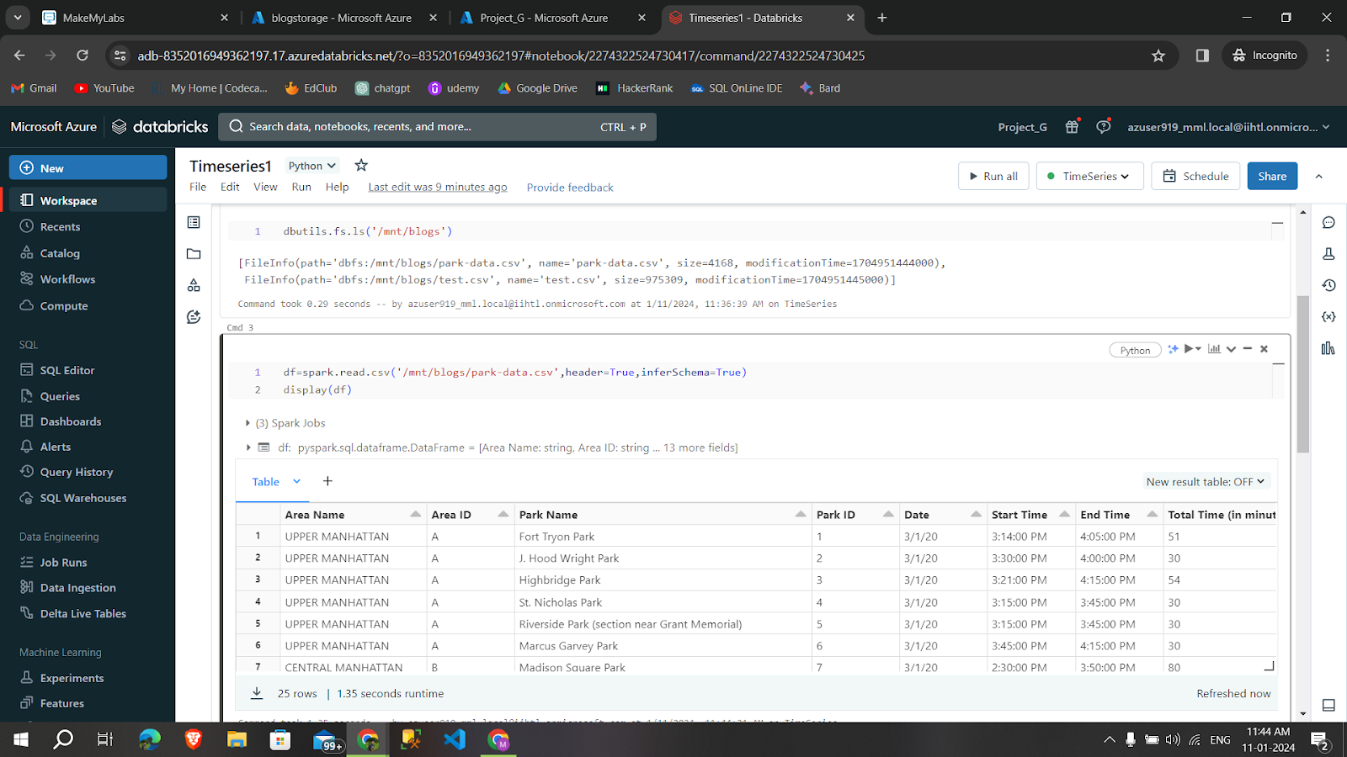
Create a Notebook and mount the storage into data bricks

Slide 13
Syntax
Syntax for mounting the storage into data bricks.
dbutils.fs.mount(source=’wasbs://containername@storageaccountname.blob.core.windows.net’,mount_point=’/mnt/mountpointname’,extra_configs={‘fs.azure.account.key.storageaccountname.blog.core.windows.net’:’access key’})
Syntax for knowing how many files are in storage account are,
dbutils.fs.ls(‘mountpointname’)
Syntax for reading a csv file:
df.spark.read.csv(‘path/to/file/’,header=True, Inferschema=true)
display(df)
Syntax for creating a temporary view:
df.createOrReplaceTempView(“name”)

Slide 14
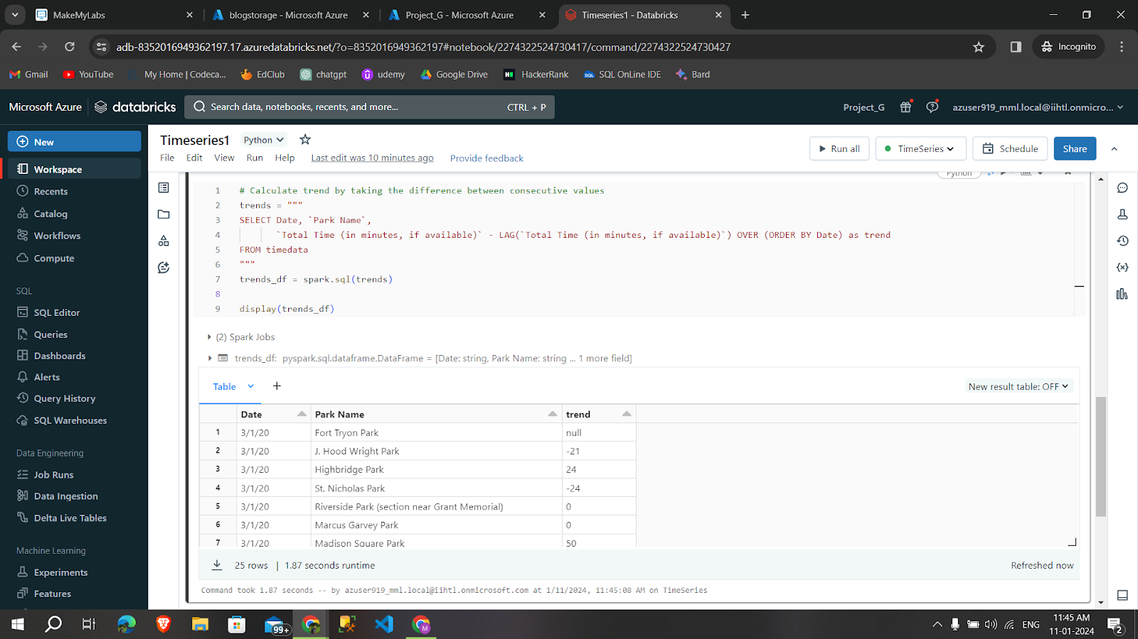
Finding Trends

Slide 15
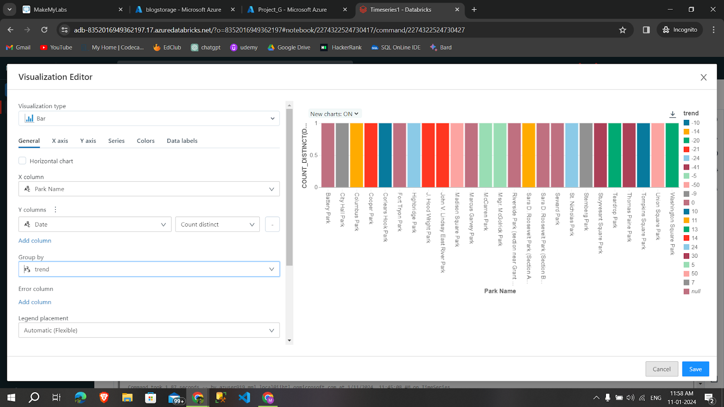
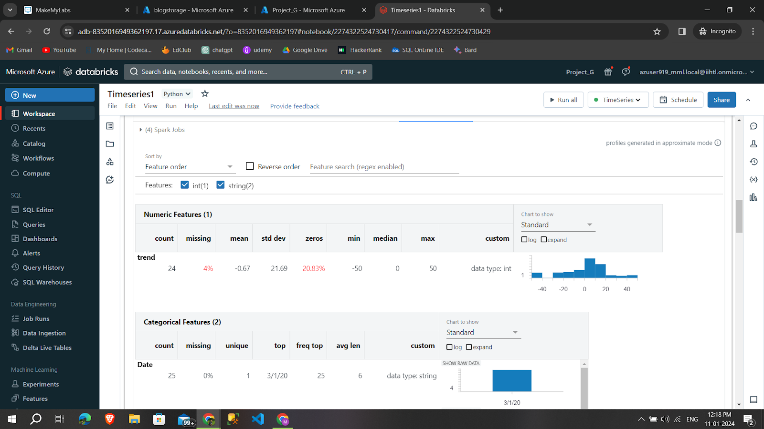
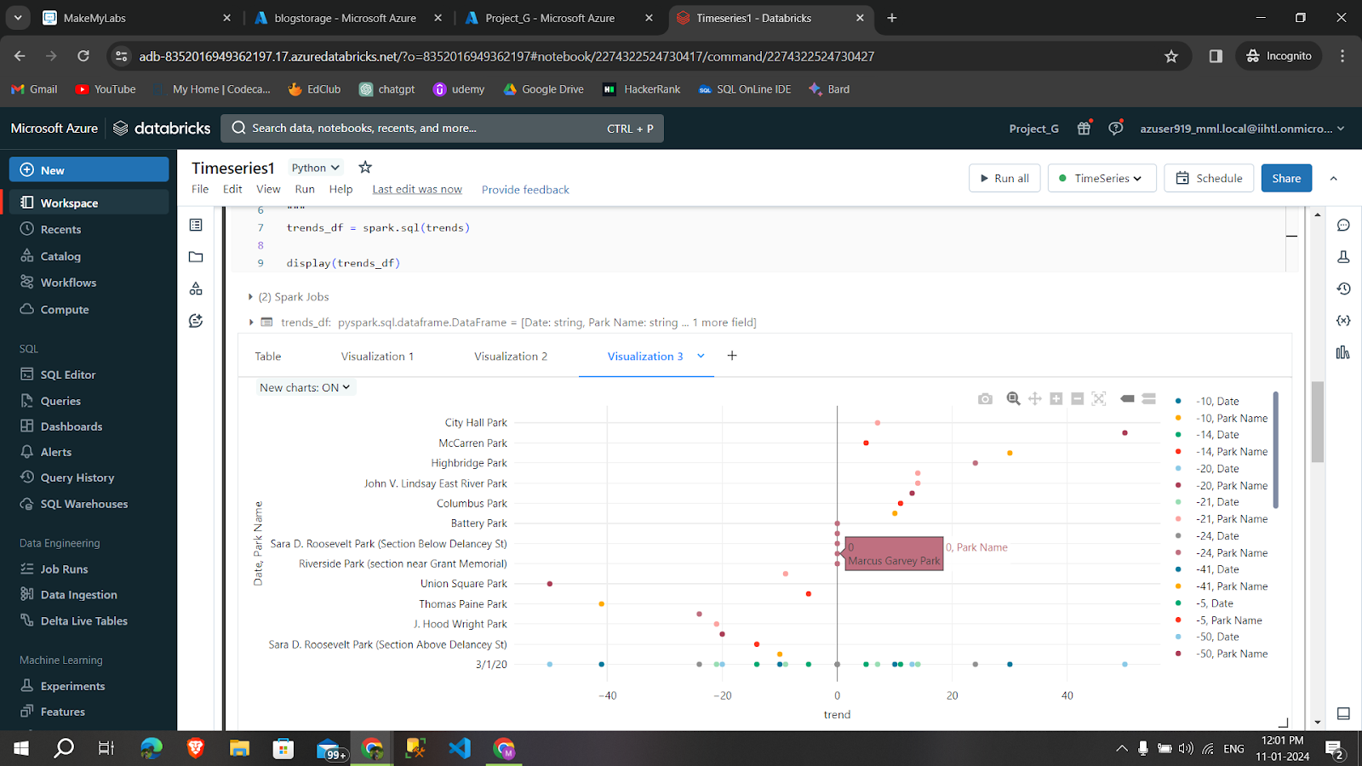
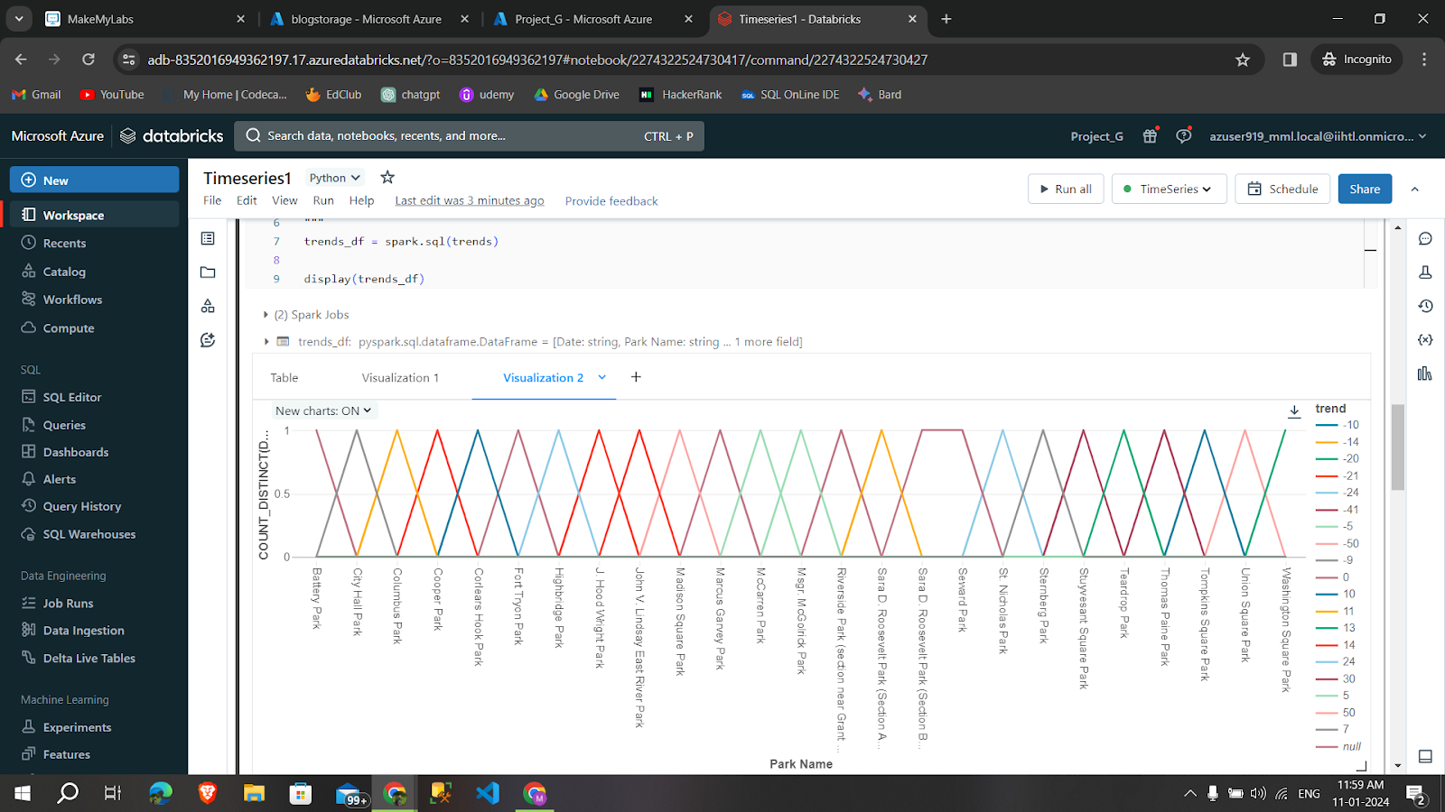
Visualization of Trends

Slide 16
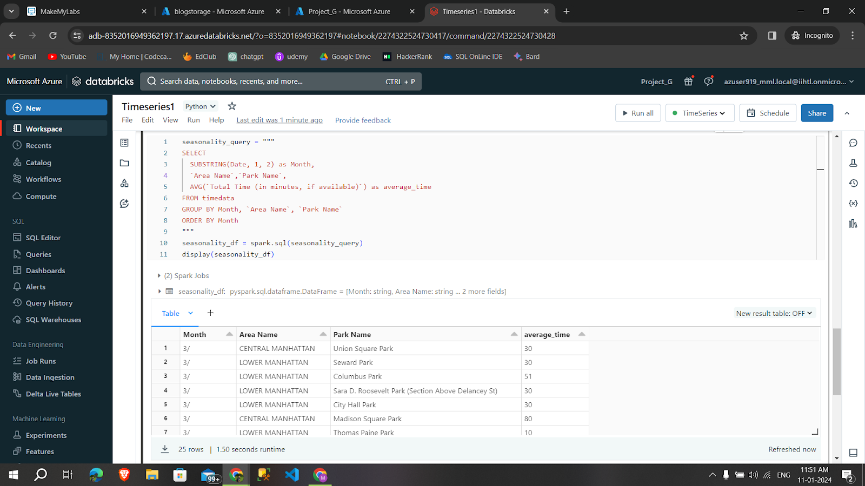
Finding Seasonality

Slide 17
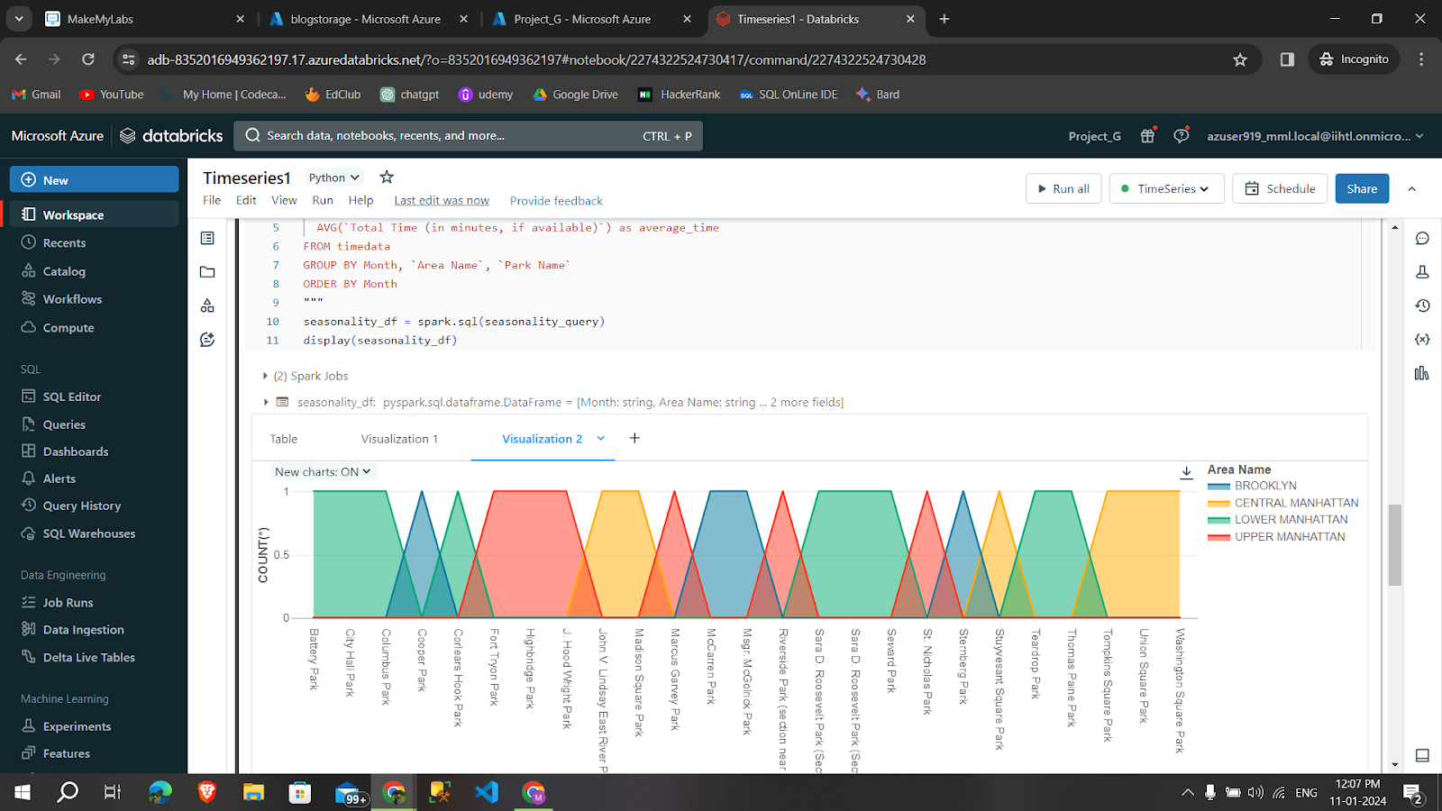

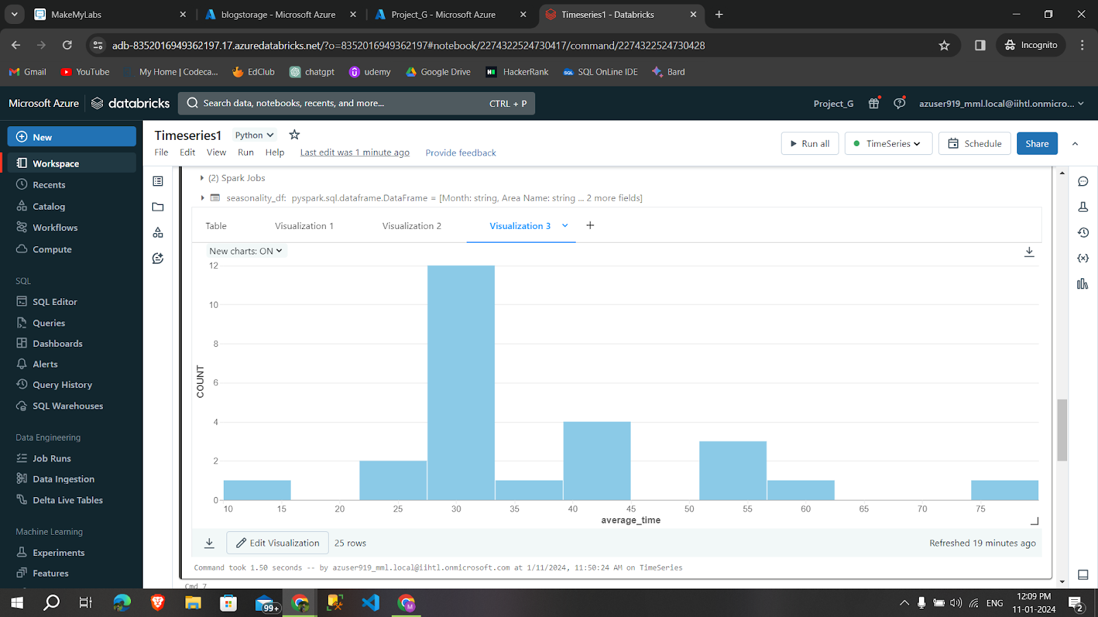
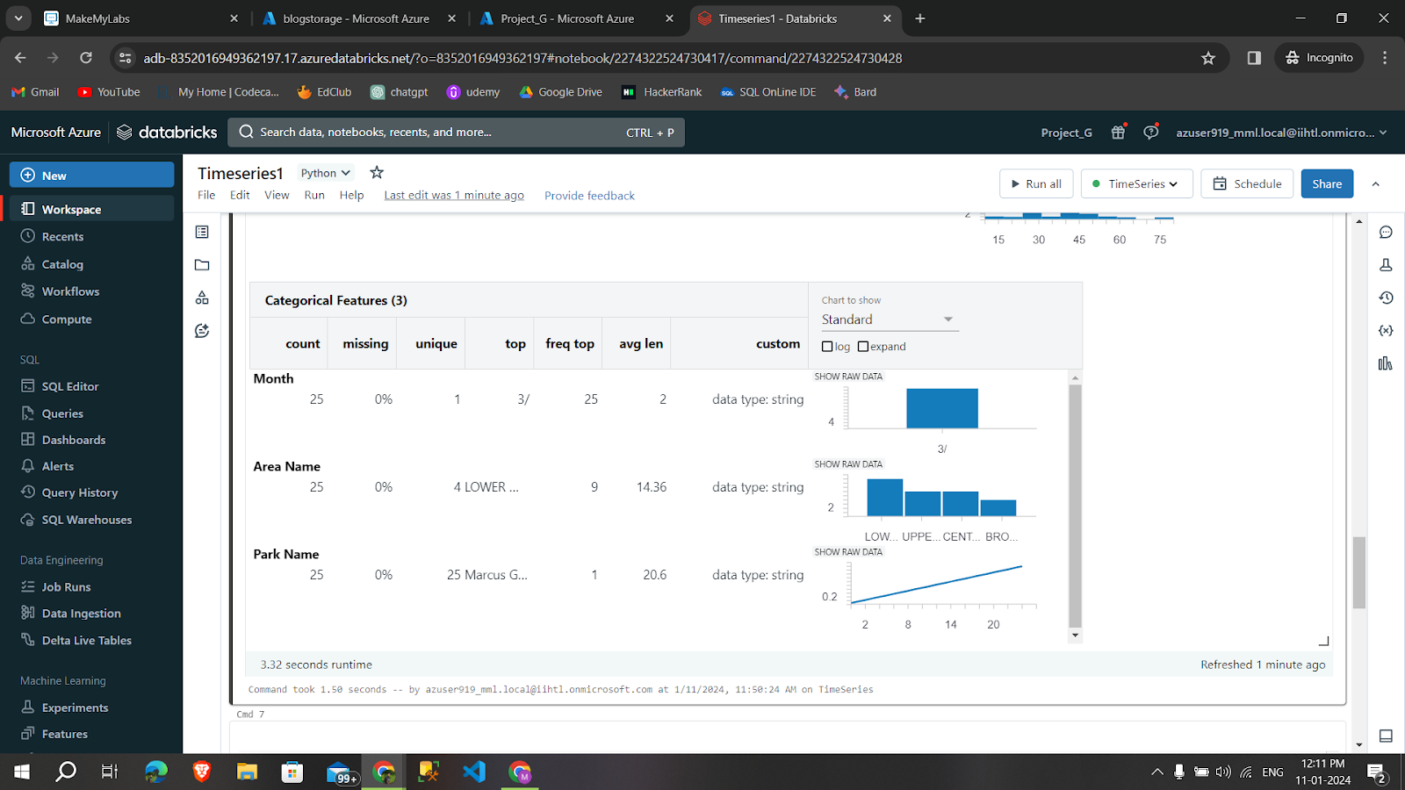
Visualization
of Seasonality

Slide 18

Finding Anomaly

Slide 19
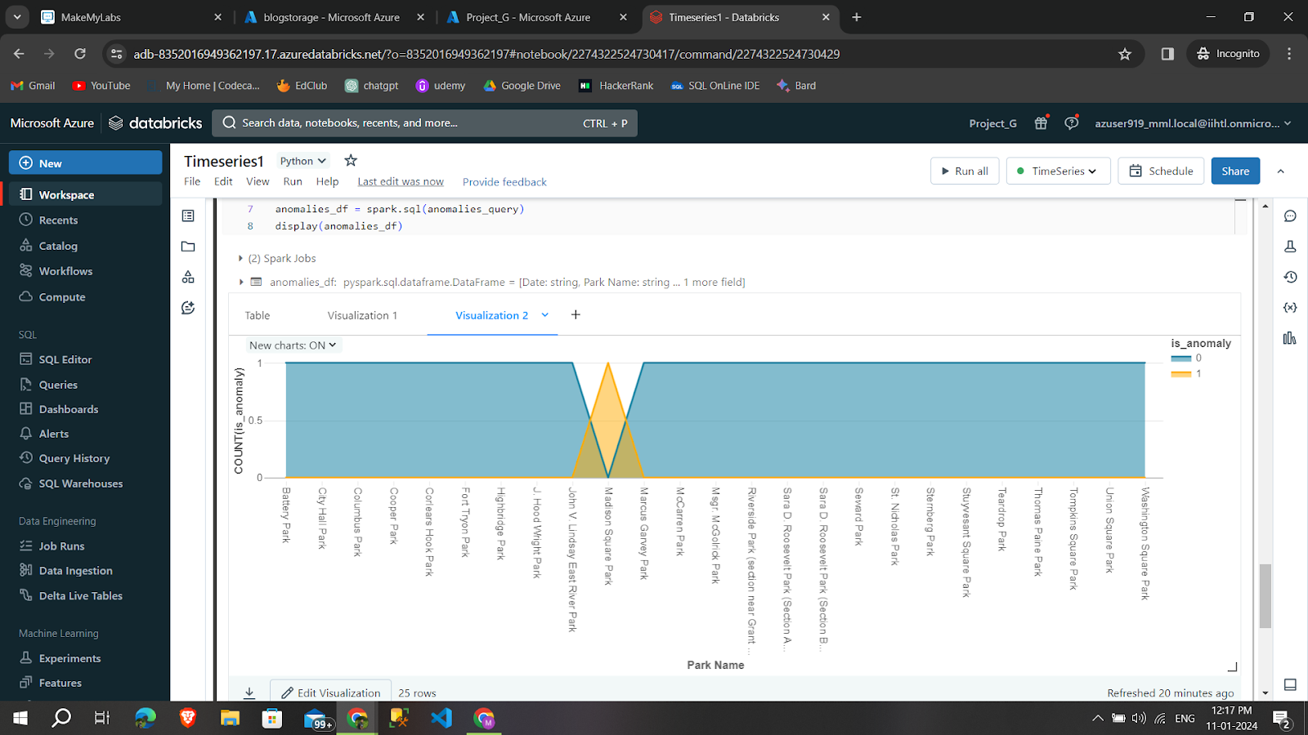
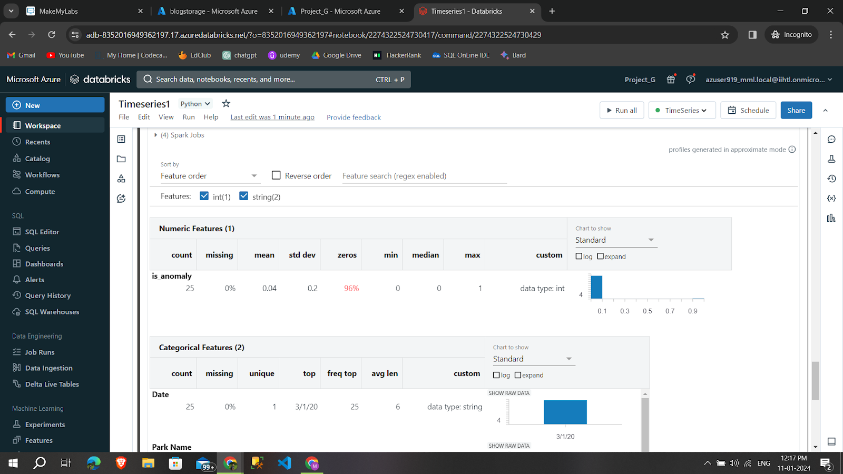
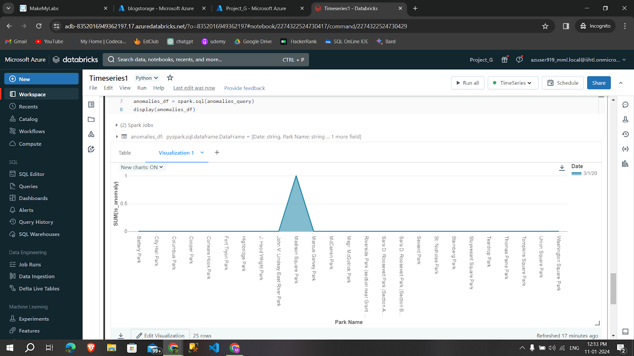
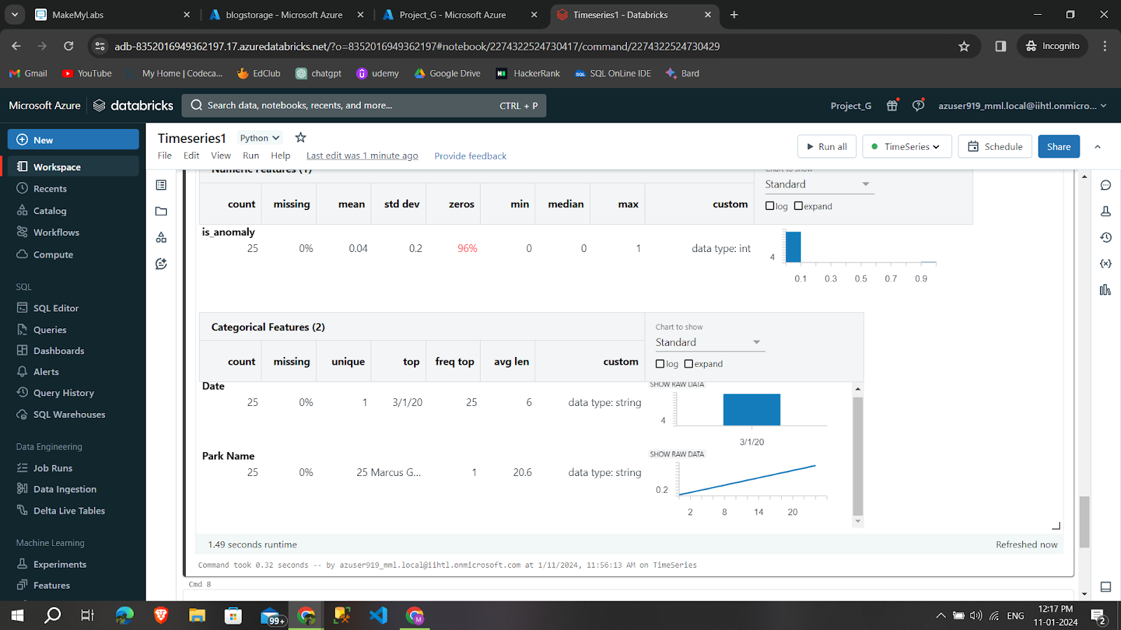
Visualization Of Anomaly

Slide 20
Conclusion
The project will demonstrate the effective use of Py Spark SQL on Azure Databricks to perform comprehensive time series analysis on time-stamped data, uncovering valuable insights for trends, seasonality, and anomalies.

Slide 21
ANY QUERIES?

Slide 22
THANK YOU

